Slide 1
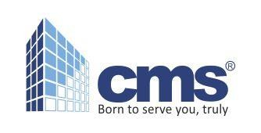


www.classicmaintenance. in

Slide 2
Brief Profile – Cleaning Services
www.classicmaintenance. in
CMS - Classic Maintenance Services is a one-stop solution for all your cleaning requirements. Our services include, daily office cleaning, carpet cleaning, hard floor cleaning and polishing, washroom hygiene, window and façade cleaning and janitorial services. We offer complete cleaning solutions for businesses of any size! We offer our services for all type of industries, commercial spaces, apartments and residential complexes.
We are always available to assist customers, through our 24/7 response centre. We can respond quickly and efficiently to all our client's needs.
We pride ourselves on providing efficient and professional service, suited
to respond to the individual needs of our esteemed Clients.

Slide 3
Vision
www.classicmaintenance. in
We see a multi skilled workforce, which consists of team players who have pride of ownership, translating organizational vision into reality.
Mission
Our Mission is to be the most successful facility management company in the world.

Slide 4
Why outsource
www.classicmaintenance. in
To concentrate on the core business
Operational Expertise
Reducing costs and improving services.
Reduce risk and increase productivity
Avoidance of capital investments
Increase flexibilities
Free from statutory hurdle
Continuous up gradation of technology, process and method

Slide 5
Client Desire
www.classicmaintenance. in
Reliable services at an optimum price
Faster delivery
Prompt response
Clean and safe environment
Motivated work force
One point contact for all needs

Slide 6
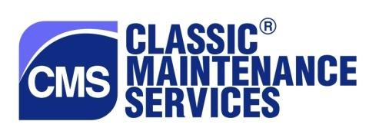
Our commitment to the client
www.classicmaintenance. in
Understand the expectations of the client
Articulate the Synergies
Spell out the strategy options
Arrive at a common strategy plan
Create a win-win solution and implement it

Slide 7
Our strengths
www.classicmaintenance. in
Having own state of art, first of its kind, well equipped training institute.
99.27 % client retention.
Our staff retention consistently remains above 90%.
100 % compliance with all statutory requirements.
High level of business ethics.
Use best quality cleaning materials and latest equipments.

Slide 8
Key Benefit to clients
www.classicmaintenance. in
Single Window
Better operational control
Easy to Operate
To minimize the operating cost of the business
To get best services within a fixed budget
Consistency of better quality
Transparent price structure contract
Trained manpower at all levels

Slide 9
Why CMS
www.classicmaintenance. in
Industry experience for over decades in Facility Management services.
20 % low cost compare to MNC’s.
Certified ISO 9001:2008 for FM services.
System and process oriented.
Provide services at a competitive price.
Achieve highest level of quality through process-driven delivery
methods.
Continue…..

Slide 10
www.classicmaintenance.in
Enhance customer’s satisfaction by outperforming quality standards.
Contribute to industry with innovative ideas.
Sound financials - timely payment of salaries, wages, statutory compliance and vendor payments.
Process driven company with a strong management team having domestic as well as international exposure.
Experience and expertise in providing facility management services to MNCs and domestic clients.
Competent team at all sites as well as back end support team
Monthly feedback from clients.

Slide 11
Training Programs
www.classicmaintenance. in
We are opened with state of the art Training Centre as “Asian Institute of Cleaning Science”
Covers all SOPs for (Hotels and Hospitals)
Our team is well trained for pre and post openings.
Complete knowledge of cleaning procedures , equipments and use of cleaning agents.
Learn to skill
Grooming and appearance.
Body language and attitude.
Rules of guest’s floors and public areas.
Greeting the guests.

Slide 12
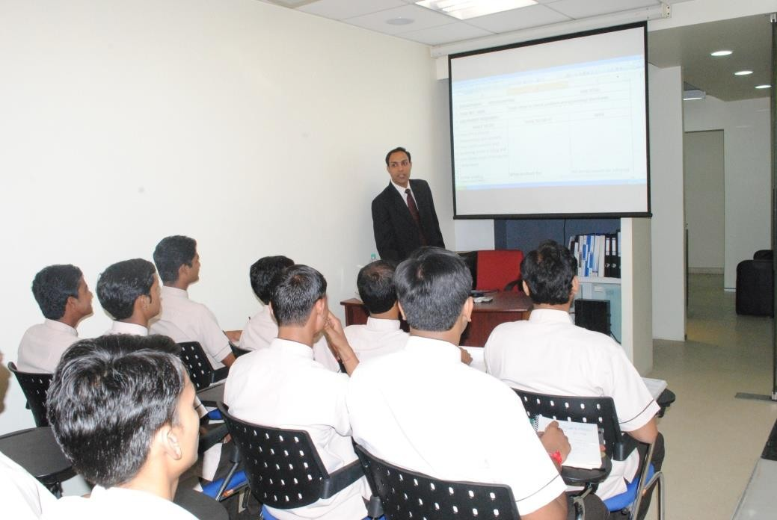
www.classic maintenance. in

Slide 13
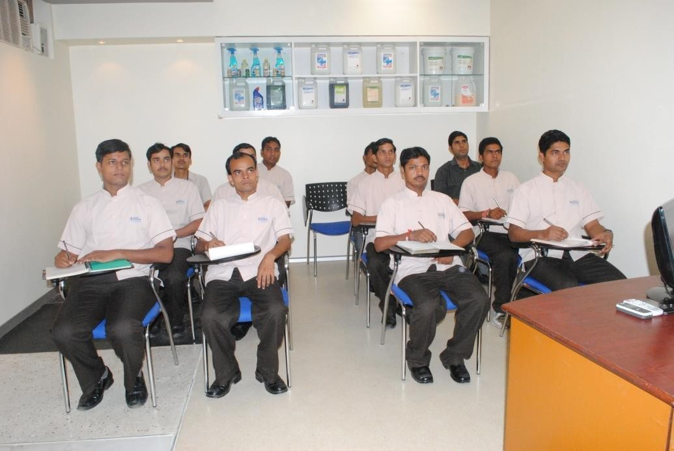
www.classicmaintenance. in

Slide 14













www.classicmaintenance. in
Organization Structure
Director
Operation Head
B D Head
H. R. Head
Asst. Mgr B D
A/C Executive
Training
Compliances
Procurement /
Distribution
Field Exts
Sup. (specialized Job work)
Site Supervisors
Co - ordinator

Slide 15












Flow Chart
w
Initial Negotiation
Technical
Commercial
Lead
Pre - Mobilization
Team is deployed at the site one week in advance for better under
standing the site.
Client meeting
Final Negotiation
Technical Commercial
Transition
Site Assessment
(with BD)
Site technical assessment
Manpower assessment
Clients inputs
Mobilization with full deployment on the actual date, as per the plan
Client ‘s Work Order
Letter Of Intent
Purchase Order
Signed Agreement
Formalities and signing of agreement
with the client.
Proposal Submission
Identification of appropriate plan.
Technical
Handover BD to Ops.
Proposal
LOI Copy
Relationship Management
Commercial Proposal
Copy of Proposal
Copy of final Cost Working
Signoff with BD & Ops.
LOI/ Costing to finance/HR/ Procurement/training.

Slide 16
Services
www.classicmaintenance. in
Janitorial/Cleaning Services
Post Construction Cleaning
Industrial Cleaning Services
Facade Cleaning - Glass Cleaning Services
Marble Polishing
A/C Servicing / Maintenance
Water Tanks / Swimming Pool Cleaning
D. G. Set Maintenance

Slide 17















Clients List

Slide 18
Thanks……..
www.classicmaintenance. in
E – 145, LGF, Chattarpur Enclave, Phase – II, New Delhi -110074
Phone No. 98734 14834, 97115 45789
www.classicmaintenance.in

